Slide 1

The Technology Value Stream
Kyle Marlia-Conner
06/01/25
Module 1

Slide 2

Introduction to the Technology Value Stream
A technology value stream is the sequence of activities required to convert a business idea into a deliverable IT product or service.
In DevOps, optimizing the value stream reduces delays, improves quality, and enhances responsiveness.
These streams include everything from coding and testing to infrastructure provisioning and deployment.
The goals of this are to shorten feedback loops, reduce waste, increase delivery speed, and continuously improve software quality.

Slide 3

Lead Time vs. Processing Time
Lead Time: The total elapsed time from the moment a request is made by the customer to the moment it is delivered.
Processing Time: The actual time spent actively working on the task or request.
Often, lead time is much longer than processing time due to delays, waiting, approvals, and handoffs.
In DevOps, identifying and minimizing this gap is key to improving overall system performance and user satisfaction.

Slide 4
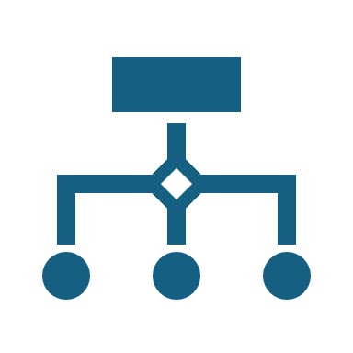
Common Scenario – Long Deployment Lead Times
Many traditional IT organizations face deployment lead times of several weeks or even months.
Common factors: siloed teams, manual testing and approval processes, inefficient workflows.
These long cycles delay feedback, complicate troubleshooting, and increase the cost of changes.

Slide 5

The DevOps Ideal – Deployment in Minutes
DevOps aims to achieve deployment lead times in minutes by removing unnecessary manual steps and embracing automation.
Continuous Integration/Delivery (CI/CD), automated testing, version control, and infrastructure as code.
Frequent, small, reliable deployments improve agility and reduce the risk of large-scale failures.
Companies like Netflix and Amazon exemplify this approach, deploying multiple times per day.

Slide 6

Tools & Practices That Reduce Lead Time
Continuous Integration (CI): Automatically integrates and tests code changes.
Continuous Delivery (CD): Automates deployment, making every change releasable.
Infrastructure as Code (IaC): Uses code to manage and provision infrastructure, ensuring consistency.
Automated Testing: Immediate validation of code correctness.
Agile and Cross-functional Teams: Improves collaboration, reduces handoffs

Slide 7

Benefits of Optimizing the Value Stream
Enables faster innovation and delivery of new features.
Improves customer satisfaction through quicker response times.
Reduces operational risk by catching issues earlier.
Empowers teams to collaborate more effectively and own the deployment lifecycle.
Leads to more predictable and manageable releases.

Slide 8

Conclusion
The technology value stream is foundational to understanding and improving software delivery.
By distinguishing between lead time and processing time, organizations can target inefficiencies.
DevOps methodologies dramatically reduce lead times, enabling near-instant feedback and faster innovation.
Embracing tools like CI/CD and IaC transforms how modern software is developed and delivered.

Slide 9
References
Kim, G., Humble, J., Debois, P., & Willis, J. (2021). Agile, Continuous Delivery, and The Three Ways. In The DevOps Handbook: How to Create World-Class Agility, Reliability, & Security in Technology Organizations (2nd ed., pp. 8–11). essay, IT Revolution Press.
Atlassian. (n.d.). What is devops? https://www.atlassian.com/devops
Brown, N. (2021, May 24). Taking devsecops to the next level with value stream mapping. SEI Blog. https://insights.sei.cmu.edu/blog/taking-devsecops-to-the-next-level-with-value-stream-mapping/#:~:text=In%20fact%2C%20The%20DevOps%20Handbook,That%20process%20includes%20product%20management

